Slide 1
MGS 723: Geodynamics
Class 20: Fluid Mechanics III
(Channel flow II)
Main reference for today: Katz and England, University of Oxford notes

Slide 2
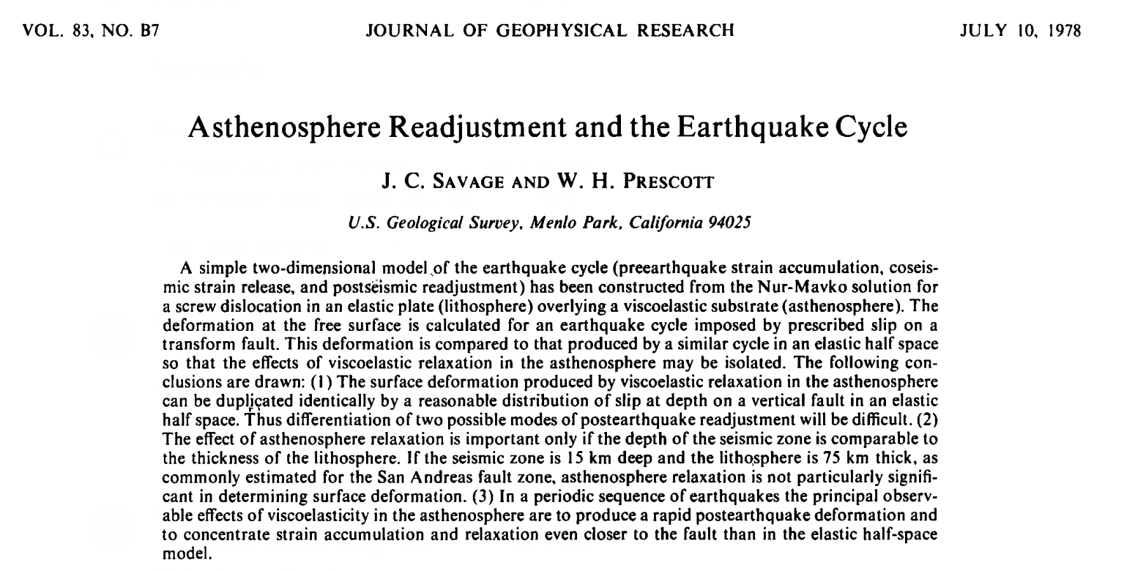
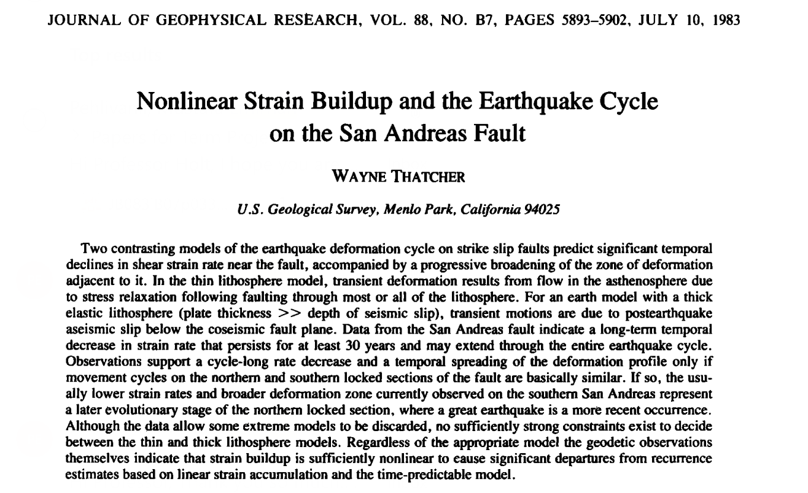
Class project: Emirhan

Slide 3
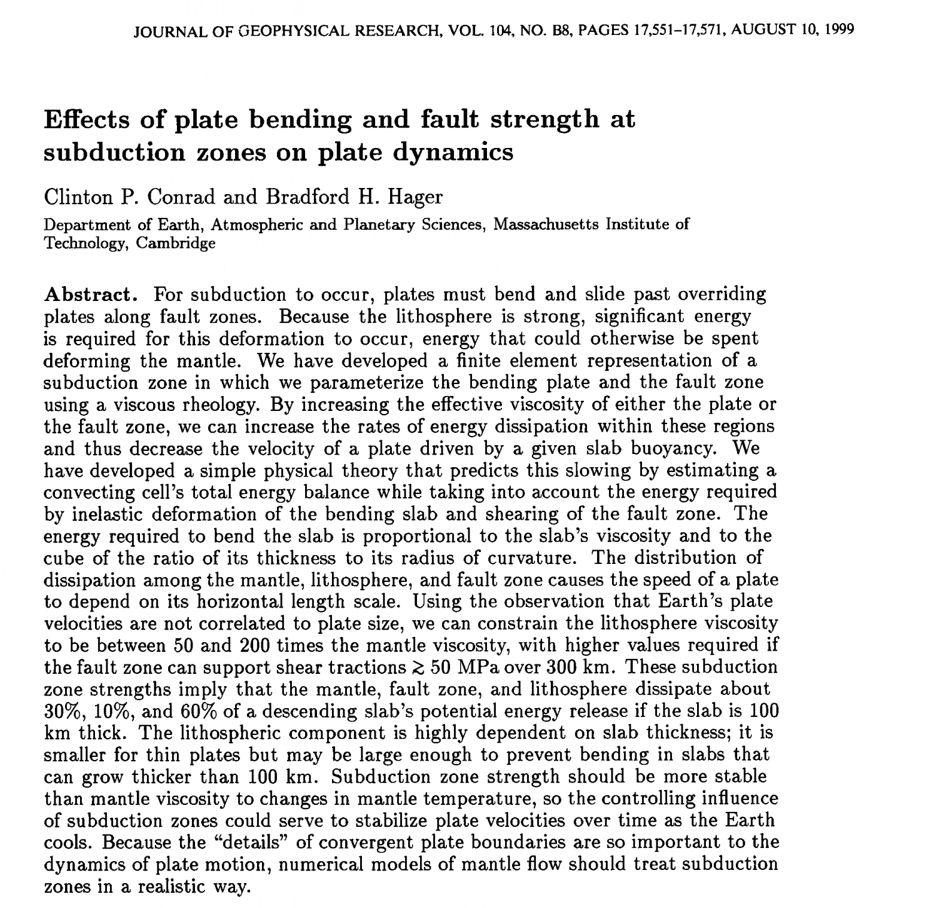
Class project: Yidan

Slide 4
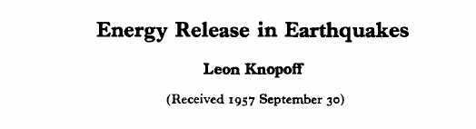
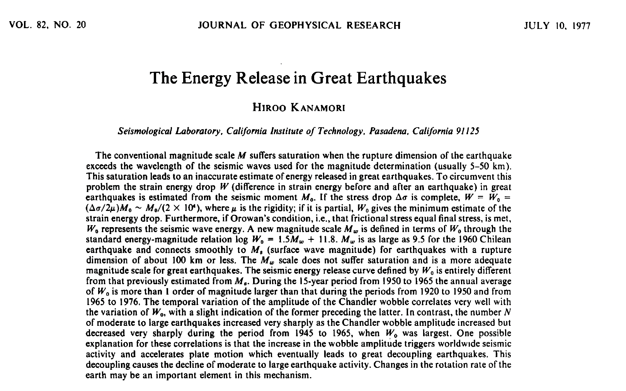
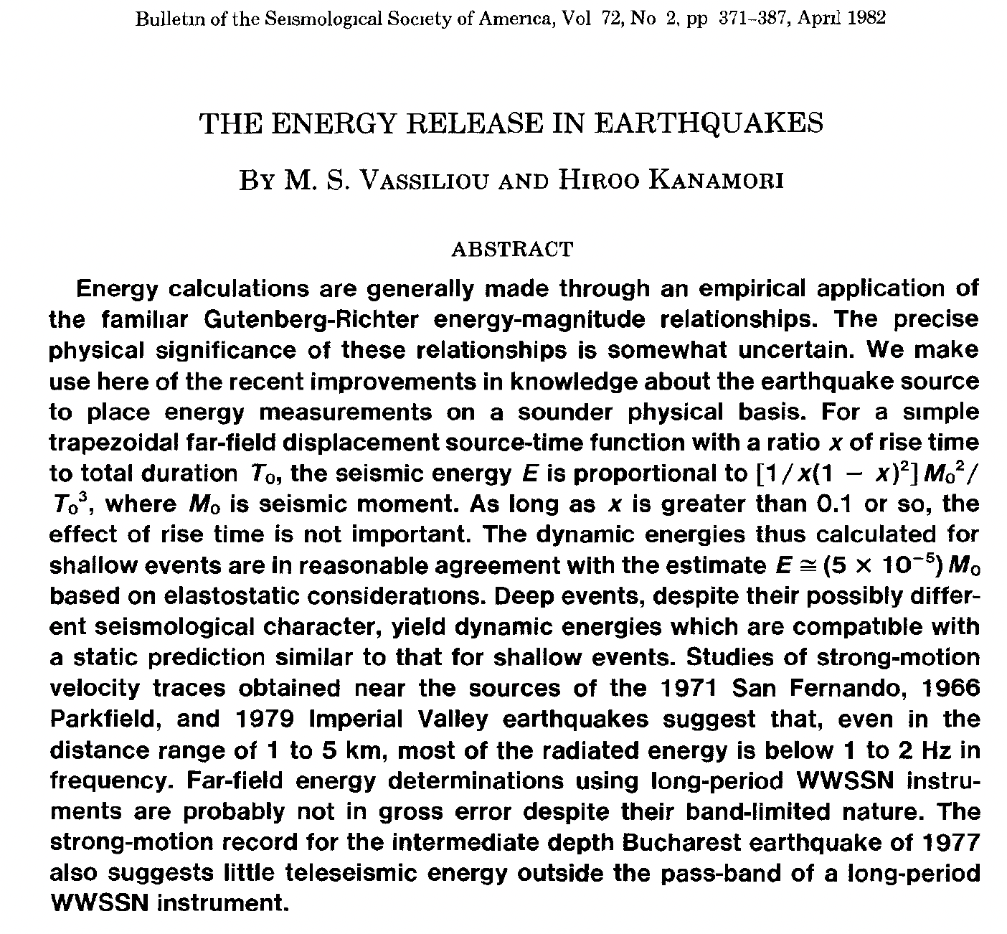
Class project: Khang

Slide 5
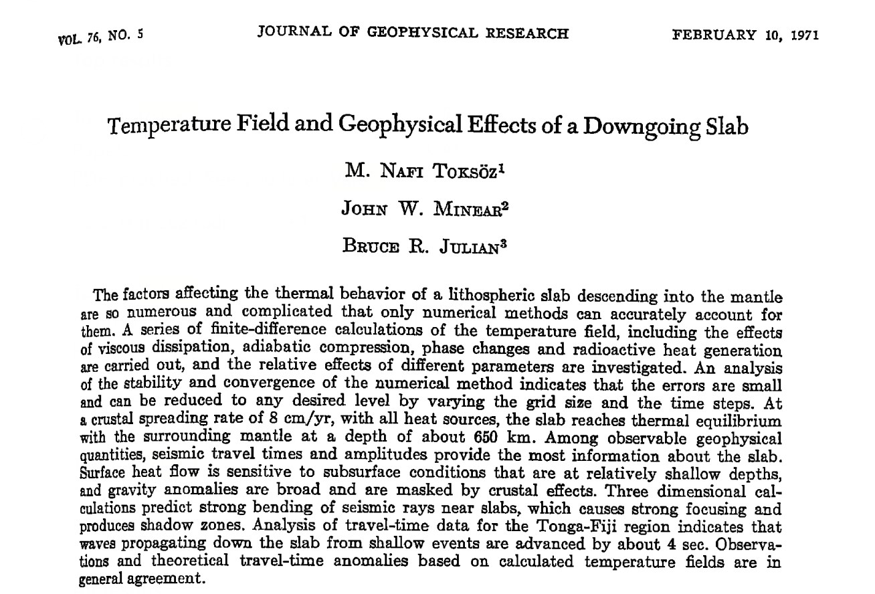
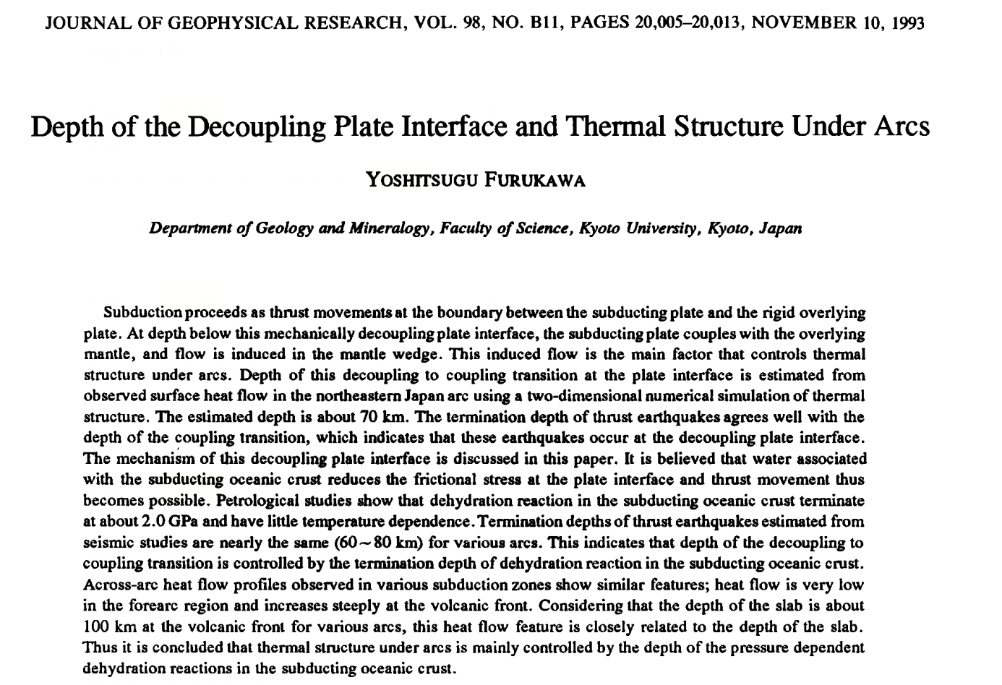
Class project: Valeria

Slide 6
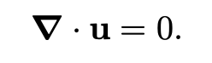

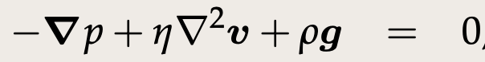
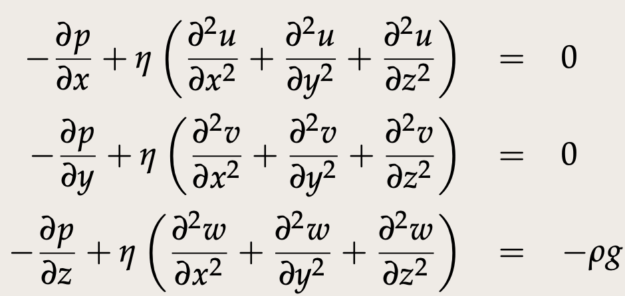
Stokes flow for incompressible, Newtonian fluid
Conservation
of mass
Conservation
of momentum
Vector form:
In full (Cartesian):
Notes:
https://www3.nd.edu/~cneal/PlanetEarth/Chapt-11a-Rock-Mechanics.pdf

Slide 7
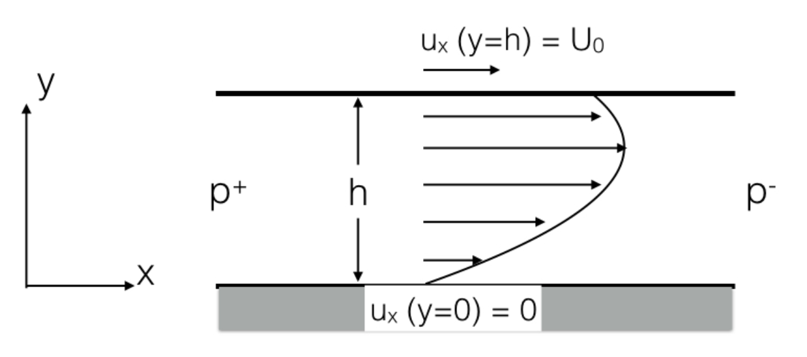
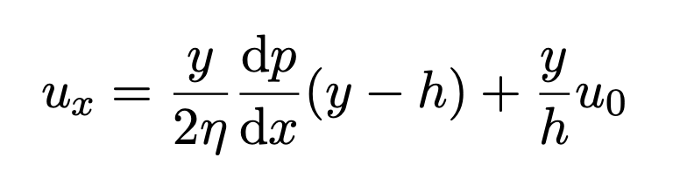
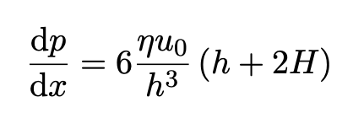
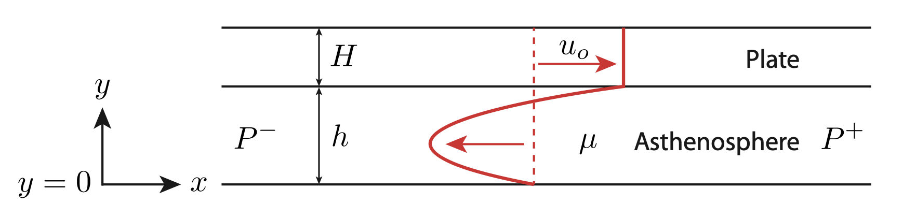
Lass class: Channel flow

Slide 8
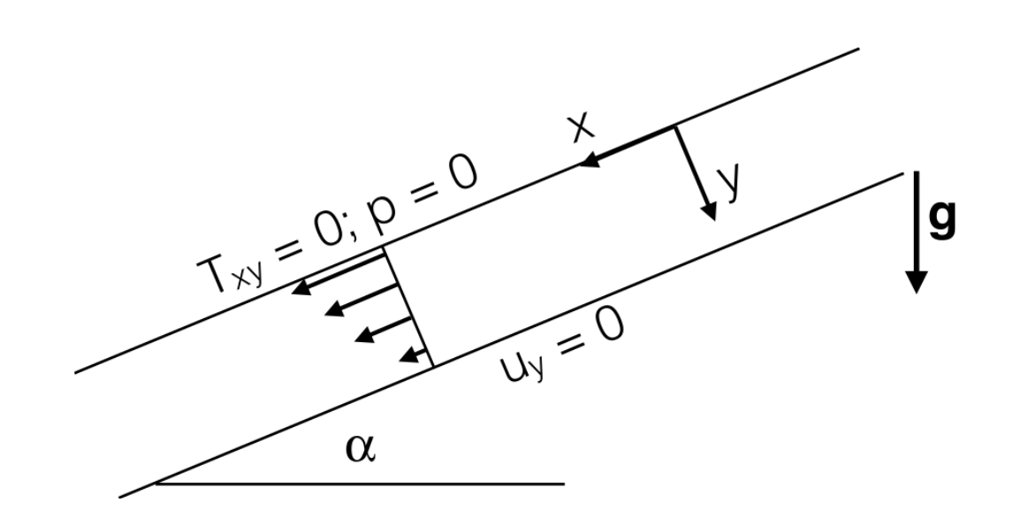
This class: Viscous flow down a slope
Katz and England, Univ. of Oxford
Notes:
https://www3.nd.edu/~cneal/PlanetEarth/Chapt-11a-Rock-Mechanics.pdf

Slide 9
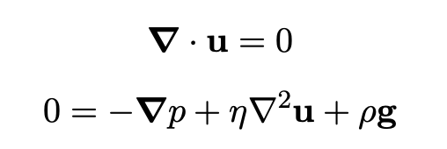
This class: Viscous flow down a slope
Key difference: Weight of material now becomes relevant
Katz and England, Univ. of Oxford
Notes:
https://www3.nd.edu/~cneal/PlanetEarth/Chapt-11a-Rock-Mechanics.pdf

Slide 10

To the stylus…
Derive 1-D viscous flow down a slope

Slide 11
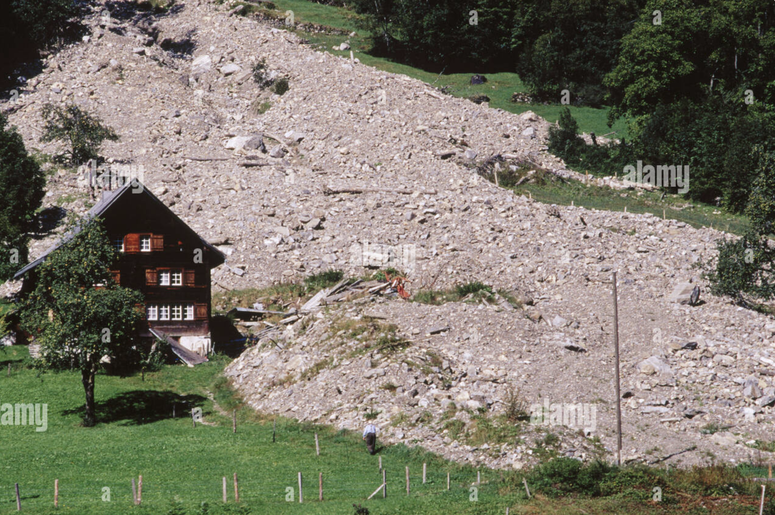
Viscous flow down a slope
A landslide in Switzerland
Notes:
https://www3.nd.edu/~cneal/PlanetEarth/Chapt-11a-Rock-Mechanics.pdf

Slide 12
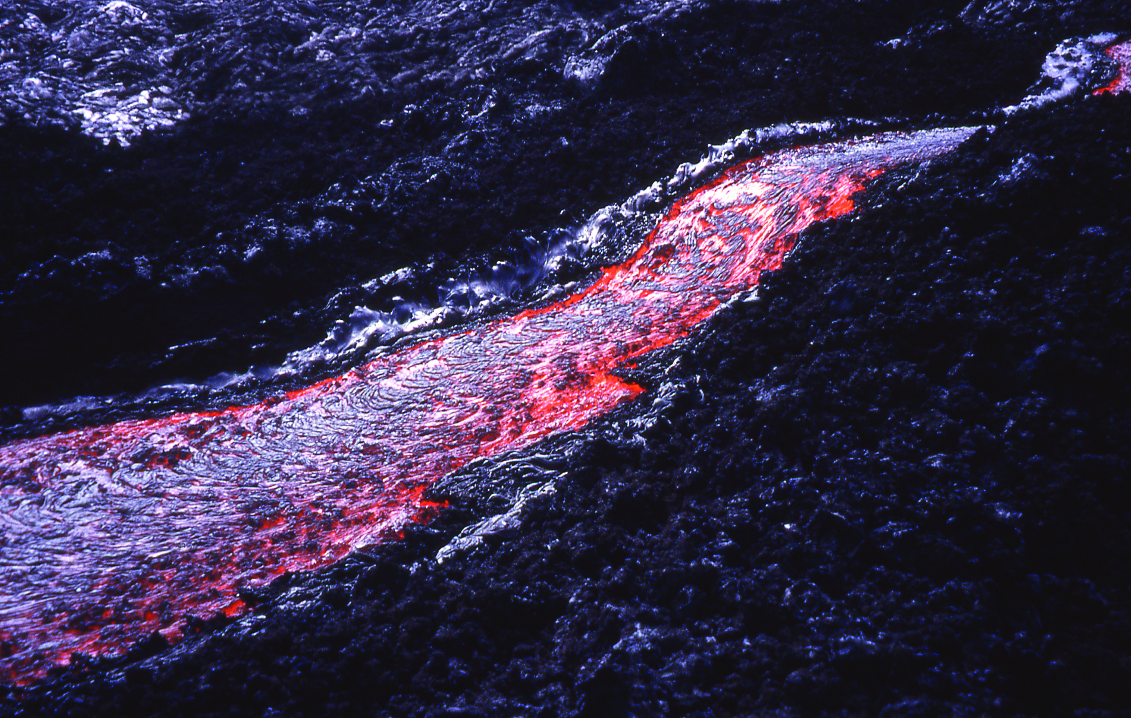
Viscous flow down a slope
Lava flow down a hill
Notes:
https://www3.nd.edu/~cneal/PlanetEarth/Chapt-11a-Rock-Mechanics.pdf

Slide 13
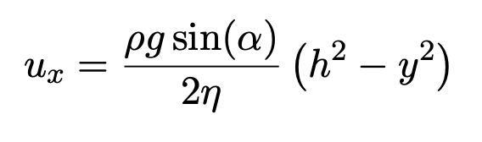
Viscous flow down a slope
Katz and England, Univ. of Oxford
Notes:
https://www3.nd.edu/~cneal/PlanetEarth/Chapt-11a-Rock-Mechanics.pdf

Slide 14
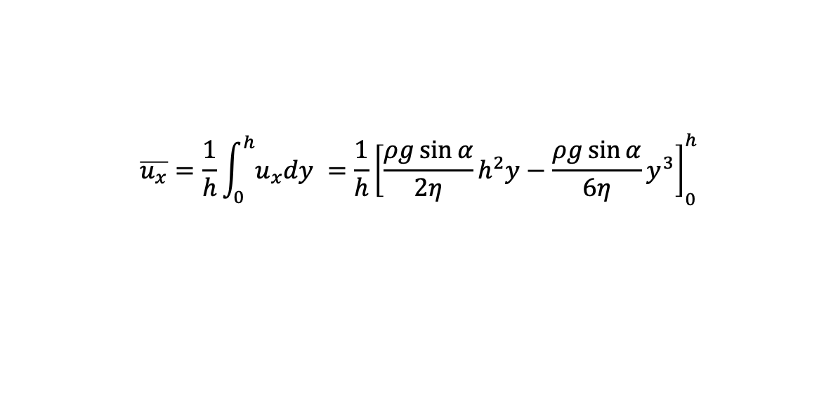
Viscous flow down a slope
Average velocity?
$$\overline{u_{x}}=\frac{1}{h}\int_{0}^{h}{u_{x}dy }={\frac{1}{h}\left[\frac{ρg\sin{α}}{2η}h^{2}y−\frac{ρg\sin{α}}{6η}y^{3}\right]}_{0}^{h}$$
Katz and England, Univ. of Oxford
Notes:
Hawaiian lava flow: http://www.geo.umass.edu/courses/volcanology/Lava%20Flows.pdf
http://geosci.uchicago.edu/~kite/doc/Griffiths_2000.pdf

Slide 15
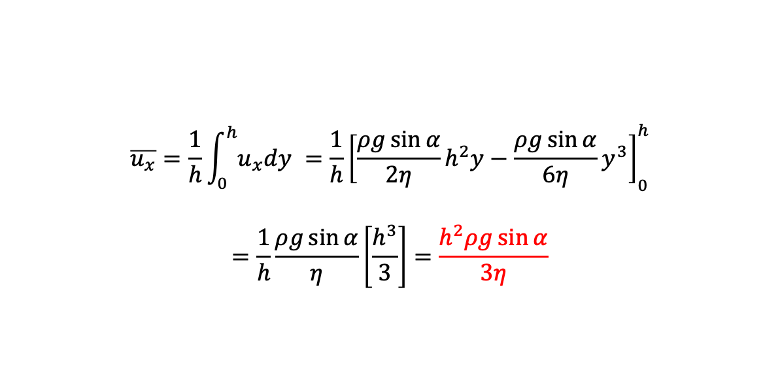
Viscous flow down a slope
Average velocity?
$$\overline{u_{x}}=\frac{1}{h}\int_{0}^{h}{u_{x}dy }={\frac{1}{h}\left[\frac{ρg\sin{α}}{2η}h^{2}y−\frac{ρg\sin{α}}{6η}y^{3}\right]}_{0}^{h}$$
$$=\frac{1}{h}\frac{ρg\sin{α}}{η}\left[\frac{h^{3}}{3}\right]=\frac{h^{2}ρg\sin{α}}{3η}$$
(Jeffreys Equation in Volcanology)
Katz and England, Univ. of Oxford
Notes:
Hawaiian lava flow: http://www.geo.umass.edu/courses/volcanology/Lava%20Flows.pdf
http://geosci.uchicago.edu/~kite/doc/Griffiths_2000.pdf

Slide 16
Viscous flow down a slope
Lava flow down a hill
Notes:
https://www3.nd.edu/~cneal/PlanetEarth/Chapt-11a-Rock-Mechanics.pdf

Slide 17

Viscous flow down a slope
Average velocity?
$$\overline{u_{x}}=\frac{1}{h}\int_{0}^{h}{u_{x}dy }={\frac{1}{h}\left[\frac{ρg\sin{α}}{2η}h^{2}y−\frac{ρg\sin{α}}{6η}y^{3}\right]}_{0}^{h}$$
$$=\frac{1}{h}\frac{ρg\sin{α}}{η}\left[\frac{h^{3}}{3}\right]=\frac{h^{2}ρg\sin{α}}{3η}$$
(Jeffreys Equation in Volcanology)
Lava flow (basaltic)
$$\overline{u_{x}} \sim \frac{2^{2}.2700.10\sin{3}°}{3.500}≈4 m/s$$
Notes:
Hawaiian lava flow: http://www.geo.umass.edu/courses/volcanology/Lava%20Flows.pdf
http://geosci.uchicago.edu/~kite/doc/Griffiths_2000.pdf

Slide 18
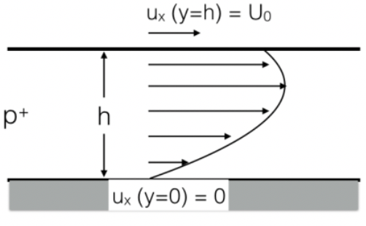

Mechanical boundary conditions
No slip:
$$ux = 0$$
2. Free slip:
$$σxy =τxy=0$$
viscous fluid: $\frac{∂u_{x}}{∂y}=0$
Free surface:
$$σyy =τyy+p=0$$
viscous fluid: $\frac{∂u_{y}}{∂y}=0$
Notes:
Hawaiian lava flow: http://www.geo.umass.edu/courses/volcanology/Lava%20Flows.pdf
http://geosci.uchicago.edu/~kite/doc/Griffiths_2000.pdf

Slide 19
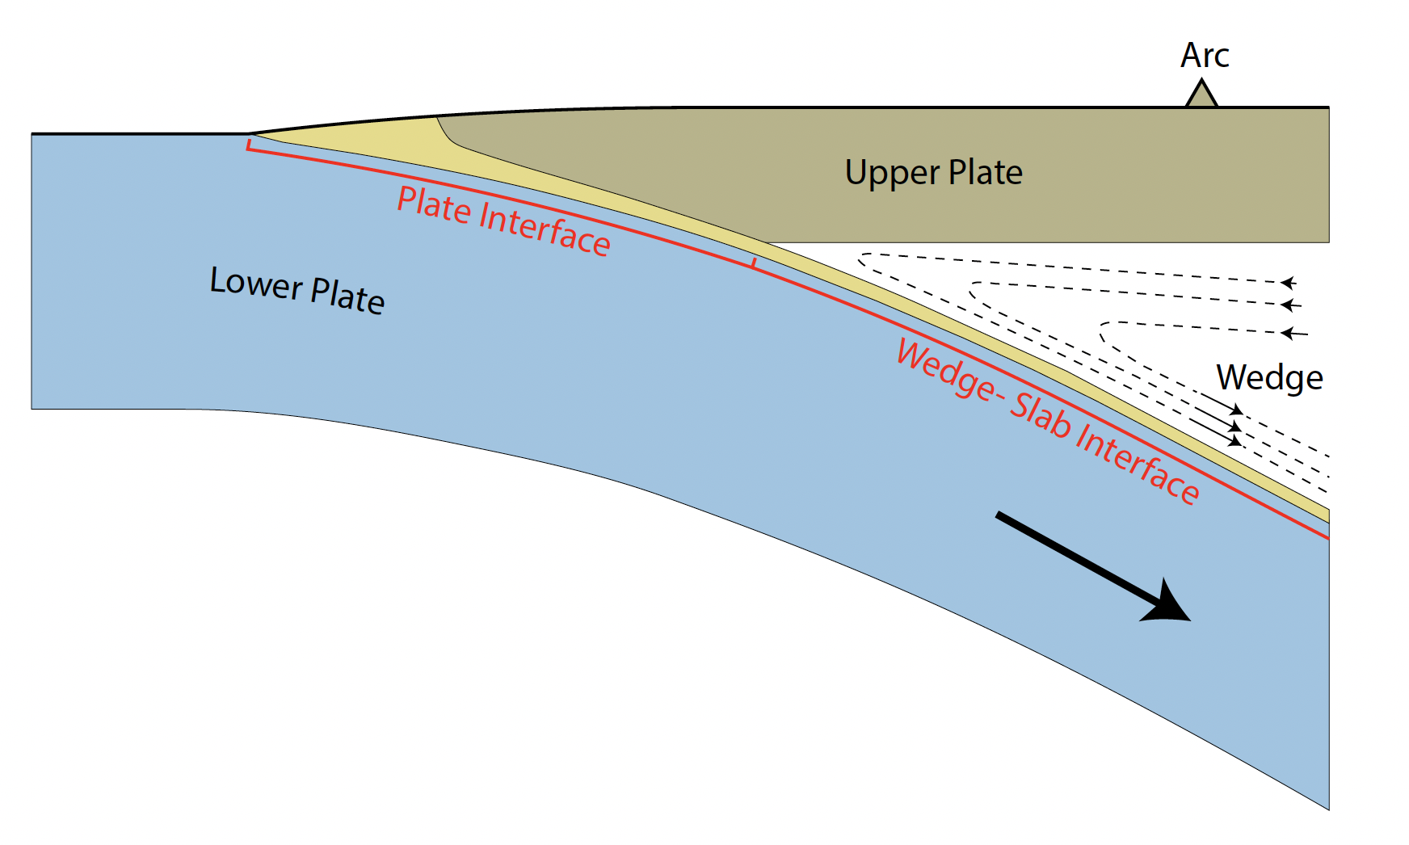
Modifiable to address flow in subduction channels
England and Smye

Slide 20
Modifiable to address flow in subduction channels
u_{x} = u_{OP}
u_{x} = u_{SP}
England and Smye

Slide 21
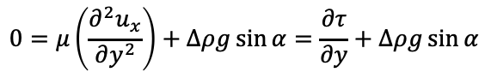
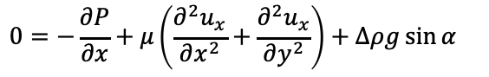
Modifiable to address flow in subduction channels
$$0=−\frac{∂P}{∂x}+μ\left(\frac{∂^{2}u_{x}}{∂x^{2}}+\frac{∂^{2}u_{x}}{∂y^{2}}\right)+∆ρg\sin{α}$$
u_{x} = u_{OP}
$$0=μ\left(\frac{∂^{2}u_{x}}{∂y^{2}}\right)+∆ρg\sin{α}=\frac{∂τ}{∂y}+∆ρg\sin{α}$$
u_{x} = u_{SP}
England and Smye

Slide 22
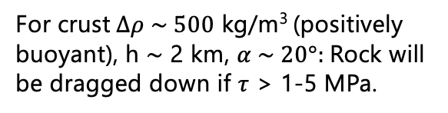
Modifiable to address flow in subduction channels
$$0=−\frac{∂P}{∂x}+μ\left(\frac{∂^{2}u_{x}}{∂x^{2}}+\frac{∂^{2}u_{x}}{∂y^{2}}\right)+∆ρg\sin{α}$$
u_{x} = u_{OP}
$$0=μ\left(\frac{∂^{2}u_{x}}{∂y^{2}}\right)+∆ρg\sin{α}=\frac{∂τ}{∂y}+∆ρg\sin{α}$$
u_{x} = u_{SP}
For crust$∆ρ \sim 500$ kg/m³ (positively buoyant), h $\sim$ 2 km, $α \sim 20°:$Rock will be dragged down if $τ$ > 1-5 MPa.
England and Smye

Slide 23
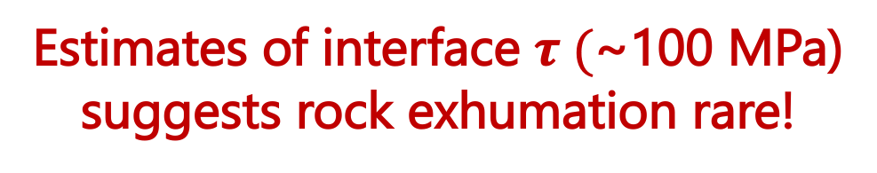
Modifiable to address flow in subduction channels
$$0=−\frac{∂P}{∂x}+μ\left(\frac{∂^{2}u_{x}}{∂x^{2}}+\frac{∂^{2}u_{x}}{∂y^{2}}\right)+∆ρg\sin{α}$$
u_{x} = u_{OP}
$$0=μ\left(\frac{∂^{2}u_{x}}{∂y^{2}}\right)+∆ρg\sin{α}=\frac{∂τ}{∂y}+∆ρg\sin{α}$$
Estimates of interface $τ ($~100 MPa)
suggests rock exhumation rare!
u_{x} = u_{SP}
For crust$∆ρ \sim 500$ kg/m³ (positively buoyant), h $\sim$ 2 km, $α \sim 20°:$Rock will be dragged down if $τ$ > 1-5 MPa.
England and Smye

Slide 24
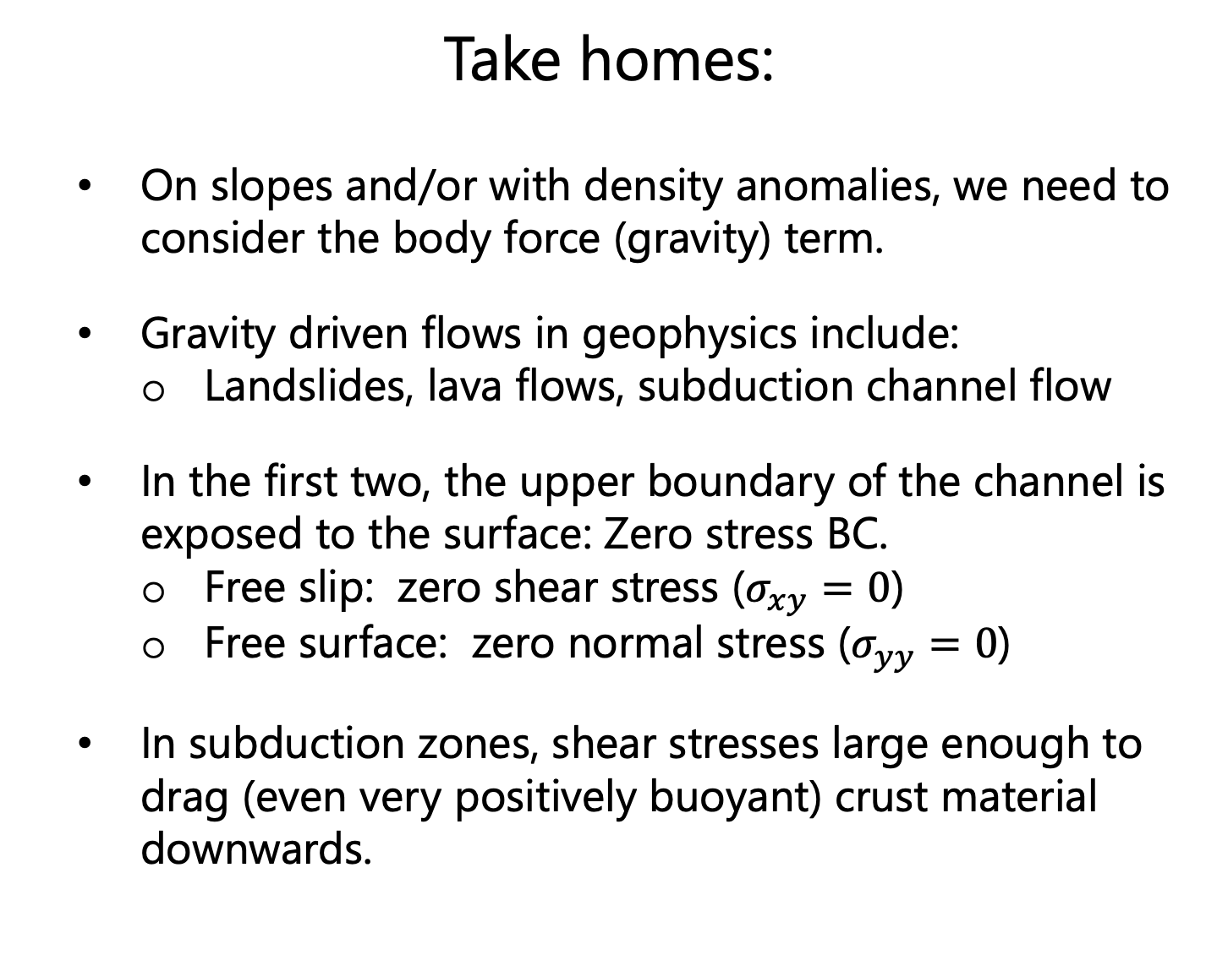
Take homes:
On slopes and/or with density anomalies, we need to consider the body force (gravity) term.
Gravity driven flows in geophysics include:
Landslides, lava flows, subduction channel flow
In the first two, the upper boundary of the channel is exposed to the surface: Zero stress BC.
Free slip: zero shear stress ($σ_{xy}=0$)
Free surface: zero normal stress ($σ_{yy}=0$)
In subduction zones, shear stresses large enough to drag (even very positively buoyant) crust material downwards.

